Slide 1
Computer Graphics
2D- VIEWING

Slide 2
Introduction
Clipping refers to the removal of part of a scene. A technique which divides each element of the picture into visible & invisible portions, allowing the invisible portion to be discarded is called clipping.
Internal clipping removes parts of a picture outside a given region & External clipping removes parts inside a region.
We'll explore internal clipping, but external clipping can almost always be accomplished as a by-product.
Types of Clipping: Point Clipping, line clipping and polygon clipping.
A line clipping algorithms takes as input two endpoints of line segment and returns one (or more) line segments.
A polygon clipper takes as input the vertices of a polygon and returns one (or more) polygons.
The algorithms that perform the job of clipping are called clipping algorithms

Slide 3
Types of Clipping
Clipping algorithms are designed to efficiently identify the portions of scene (in viewing coordinates) that lie inside a given viewport.
Point Clipping
It is the technique related to proper display of points in the scene, although, this type of clipping is used less frequently in comparison to other types, i.e., line and polygon clipping. But, in some situations, e.g., the scenes which involve particle movements such as explosion, dust etc., it is quite useful.
let us assume that the clip window is rectangular in shape.
The maximum and minimum coordinate value are i.e., (xwmax, ywmax) and (xwmin, ywmin) are sufficient to specify window size, and any point (x,y), which can be shown or displayed should satisfying the inequalities. Otherwise, the point will not be visible. Thus, the point will be clipped or not can be decided on the basis of the inequalities.

Slide 4
Point Clipping
Clipping window
yw_{max}
yw_{min}
xw_{min}
xw_{max}
Trivial: Save point P = (x,y) if it’s in the box:

Slide 5
Clipping Points
Given a point (x, y)and clipping window (xw_{min}, yw_{min}), (xw_{max}, yw_{max}), determine if the point should be drawn
(xwmax,ywmax)
(x,y)
(xwmin,ywmin)

Slide 6
Clipping Points
Given a point (x, y)and clipping window (xw_{min}, yw_{min}), (xw_{max}, yw_{max}), determine if the point should be drawn
(xwmax,ywmax)
(x,y)
xwmin<=x<=xwmax?
(xwmin,ywmin)
ywmin<=y<=ywmax?

Slide 7
Clipping Points
Given a point (x, y)and clipping window (xw_{min}, yw_{min}), (xw_{max}, yw_{max}), determine if the point should be drawn
(xwmax,ywmax)
(x1,y1)
(x2,y2)
(xwmin,ywmin)
xwmin<=x<=xwmax?
ywmin<=y<=ywmax?

Slide 8
Clipping Points
Given a point (x, y)and clipping window (xw_{min}, yw_{min}), (xw_{max}, yw_{max}), determine if the point should be drawn
(xwmax,ywmax)
(x1,y1)
(x2,y2)
xwmin<=x2<=xwmax? No
(xwmin,ywmin)
ywmin<=y2<=ywmax Yes

Slide 9
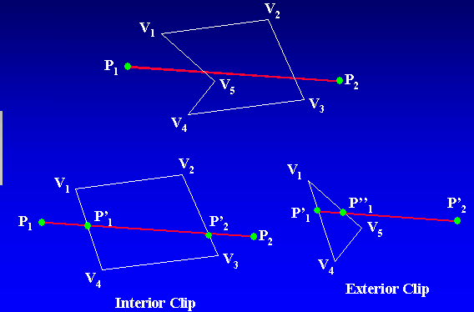
Line Clipping
Internal clipping removes parts of a picture outside a given region & External clipping removes parts inside a region.

Slide 10
Window and clipping
The method for selecting and enlarging portions of a drawing is called windowing and the technique for not showing the part of the drawing which one is not interested is called clipping
Window
A world-coordinate area selected for display. defines what is to be viewed
Viewport
An area on a display device to which a window is mapped.
defines where it is to be displayed
Viewing transformation
The mapping of a part of a world-coordinate scene to device coordinates.
A window could be a rectangle to have any orientation.
It is the window that specifies what is to be shown or displayed whereas viewport specifies where it is to be shown or displayed.
Specifying these two coordinates, i.e., window and viewport coordinates and then the transformation from window to viewport coordinates is very essential from the point of view of clipping.

Slide 11
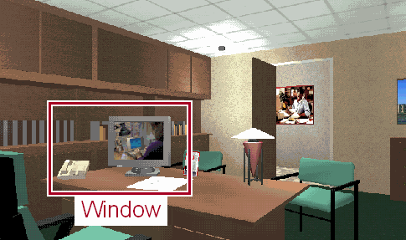
Clipping
Avoid Drawing Parts of Primitives Outside Window
Window defines part of scene being viewed
Must draw geometric primitives only inside window
World
Coordinates

Slide 12
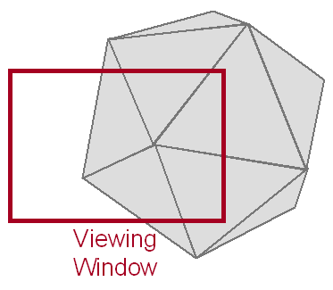
Clipping
Avoid Drawing Parts of Primitives Outside Window
Window defines part of scene being viewed
Must draw geometric primitives only inside window

Slide 13
Viewing & Clipping
When we define an image in some world coordinate system, to display that image we must map the image to the physical output device. This is a two stage process. For 3 dimensional images we must first determine the 3D camera viewpoint, called the View Reference Point (VRP) and orientation. Then we project from 3D to 2D, since our display device is 2 dimensional. Next, we must map the 2D representation to the physical device.
Example: Graphic program which draw an entire building by an architect but we only interested on the ground floor. Map of sales for entire region but we only like to know from certain region of the country.

Slide 14
Clipping Points
Given a point (x, y)and clipping window (xw_{min}, yw_{min}), (xw_{max}, yw_{max}), determine if the point should be drawn
(xwmax,ywmax)
(x1,y1)
(x2,y2)
(xwmin,ywmin)
xwmin<=x1<=xwmax? Yes
ywmin<=y1<=ywmax Yes

Slide 15
Line Clipping
A variety of line clipping algorithms are available in the world of computer graphics, but we restrict our discussion to the following Line clipping algorithms:
Cohen Sutherland algorithm
Mid Point Subdivision Algorithm
To clip a line, we need to consider only its endpoints, not its infinitely many interior points.
If both endpoints of a line lie inside the clip rectangle, the entire line lies inside the clip rectangle and can be trivially accepted.
If one endpoint lies inside and one outside, the line intersects the clip rectangle and we must compute the intersection point.
If both endpoints are outside the clip rectangle, the line may or may not intersect with the clip rectangle, and we need to perform further calculations to determine whether there are any intersections.

Slide 16
Line Clipping
Find the Part of a Line Inside the Clip Window
P₇
P₁
P₄
P₈
P₃
P₂
P₆
P₁₀
P₅
Before Clipping
P₉

Slide 17
Line Clipping
Find the Part of a Line Inside the Clip Window
P’₇
P₄
P’₈
P₃
P₆
P’₅
After Clipping

Slide 18
Cohen-Sutherland Algorithm
A rapid divide-and-conquer approach to the line clipping
Clipping window
Trivial Accept: When both end points are inside the window, and therefore the line is completely visible.
Trivial Reject: When both end points are outside the window and on the same side of the window. Then the line is completely outside, and hence can be rejected.

Slide 19
Region Codes
A point is assigned a unique region code depending on the location of the point with respect to the window.
A
B
R
L
1001
1000
1010
0001
0000
0010
Clipping window
0101
0100
0110

Slide 20
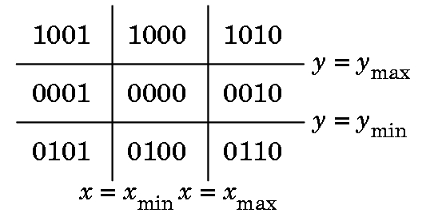
Cohen-Sutherland Line Clipping
Extend the window’s sides to infinity and break up space into 9 regions.
Each region is assigned a 4-bit binary out code, b₁b₂b₃b₄, as follows.
Bit 1: End point is above the window if y>ymax
Bit 2: End point is below the window if y<ymin
Bit 3: End point is right of the window if x>xmax
Bit 4: End point is left to the window if x<xmin

Slide 21
Cohen-Sutherland Line Clipping
Now, to perform Line clipping for various line segment which may reside inside the window region fully or partially, or may not even lie in the window region; we use the tool of logical AND between the region codes of the points lying on the line.
If both the end point codes are 0000,the line is visible.
If the logical AND of the endpoint codes is not 0000,the line segment is not visible.
If the logical AND of the endpoint codes is 0000,the line segment is clipping candidate.

Slide 22
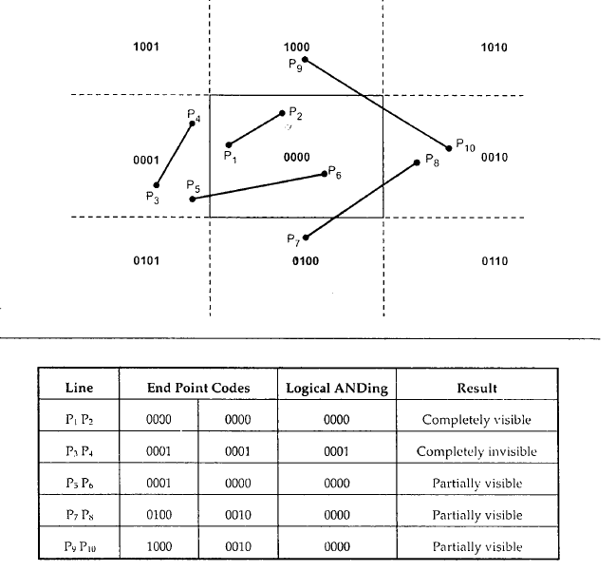
Cohen-Sutherland Line Clipping

Slide 23
Region Codes
1010
0000
Trivial Accept
0000

Slide 24
Cohen-Sutherland Line Clipping
Computing Intersection Point
Intersection points with a clipping boundary can be calculated using the slope- intercept form of the line equation.
The equation of any line with slope m is y=mx+c
If it passes through (x1,y1) then y1=mx1+c
Subtracting y-y1=m(x-x1) where m= (Line is passing through (x1,y1) & (x2,y2)
Determine the intersecting boundary
If bit1 is 1,intersect with line y=ymax
If bit2 is 1,intersect with line y=ymin
If bit3 is 1,intersect with line x=xmax
If bit4 is 1,intersect with line x=xmin

Slide 25
Cohen-Sutherland Line Intersection & Clipping
Q
A
P
x=xmin
x=xmax
The equation of the line PQ is
The intersection point A lies on the left edge and therefore its x-coordinate is x = xmin.
To get the y-coordinate of A, we substitute for x in the above equation of PQ:
y = where m=
Similarly,
x=x1+ where m=

Slide 26
Cohen-Sutherland Line Intersection & Clipping
The coordinates of the intersection point are:
If boundary line is vertical
y=
Where x value depends
The intersection point lies on the left edge and therefore its x-coordinate is x = xmin.
The intersection point lies on the Right edge and therefore its x-coordinate is x = xmax.
If the boundary line is horizontal
x=
Where y value depends
The intersection point lies on the below edge and therefore its y-coordinate is y = ymin.
The intersection point lies on the Above edge and therefore its y-coordinate is y = ymax.

Slide 27
Cohen-Sutherland Line Clipping
Algorithm
Accept the end points of the line segment and window boundaries i.e.x1,y1,x2,y2,xmin,xmax,ymin,ymax.
Assign a 4 bit code to each end point of the line segment i.e. b₁b₂b₃b₄, as follows

Slide 28
Cohen-Sutherland Line Clipping
Test using end point codes & Logical AND
If both the end point codes are 0000,the line is visible.
If the logical AND of the endpoint codes is not 0000,the line segment is not visible.
If the logical AND of the endpoint codes is 0000,the line segment is clipping candidate.
Determine the intersecting boundary
If bit1 is 1,intersect with line y=ymax
If bit2 is 1,intersect with line y=ymin
If bit3 is 1,intersect with line x=xmax
If bit4 is 1,intersect with line x=xmin

Slide 29
Cohen-Sutherland Line Clipping
Determine the intersecting point coordinates (x,y).The equation of a line passing through (x1,y1) and (x2,y2) and (x,y) will be
If boundary line is vertical
Where x value depends
The intersection point lies on the left edge and therefore its x-coordinate is x = xmin.
The intersection point lies on the Right edge and therefore its x-coordinate is x = xmax
If the boundary line is horizontal
Where y value depends
The intersection point lies on the below edge and therefore its y-coordinate is y = ymin.
The intersection point lies on the Above edge and therefore its y-coordinate is y = ymax.
Go to Step 2.
Draw the remaining line segments .
Stop.

Slide 30
Cohen-Sutherland Line Clipping
Example1
B
A
(8,8)
D
Line AB : A(3,10), B(6,12)
CD : C(4,1), D(10,6)
(2,2)
C

Slide 31
Cohen-Sutherland Line Clipping
Encode end points
1000
B
A
(8,8)
AB A(3,10) 1000
B(6,12) 1000
Logical AND 1000
CD C( 4, 1) 0100
D(10,6) 0010
Logical AND 0000
D
0010
Invisible
Indeterminate
(2,2)
C
0100
Clip line CD

Slide 32
Cohen-Sutherland Line Clipping
Example2
A line from (2, 7) to (8, 12) in a window (Xmin = Ymin = 5 and Xmax = Ymax = 10)
1000
P2
P2’
Ymax
P1’
0001
P1
Ymin
Xmin
Xmax

Slide 33
Cohen-Sutherland Line Clipping
The region code of point P1(2,7)=0001
The region code of point P2(8,12)=1000
The line is partially visible.(logical AND is 0000)
The point of intersection of point P1 with the left boundary is =(xmin,y)
The point of intersection of the point P2 with the top boundary is (x,ymax)
So the finally visible portion of the line would be between (5,9.5) and (5.6,10).

Slide 34
Cohen-Sutherland Line Clipping
Intersection calculations are expensive. Find first lines completely inside or certainly outside clipping window. Apply intersection only to undecided lines.
Perform cheaper tests before proceeding to expensive intersection calculations.
Completely inside / certainly outside tests involve only logic operations of bits.
Can be easily extended to 3D clipping using 6-bit out codes .
Floating-point arithmetic required
Requires only floating-point subtractions and Boolean operations for decision test.
A single division is required for intersection computation.
The algorithm is only applicable to rectangular windows and not to any other convex shaped window.

Slide 35
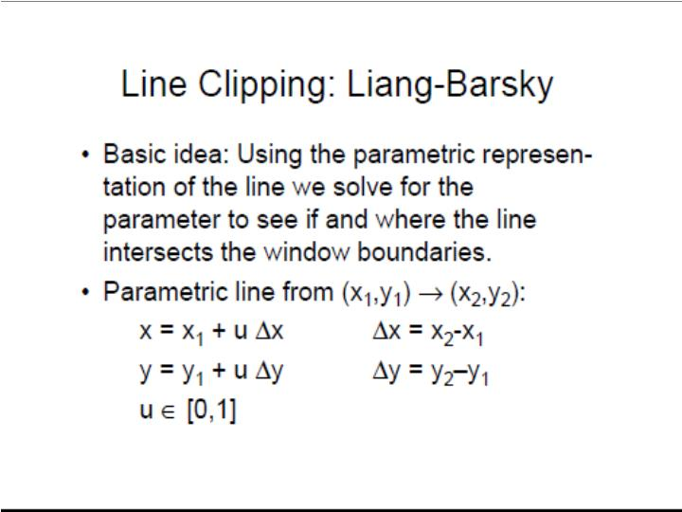

Slide 36
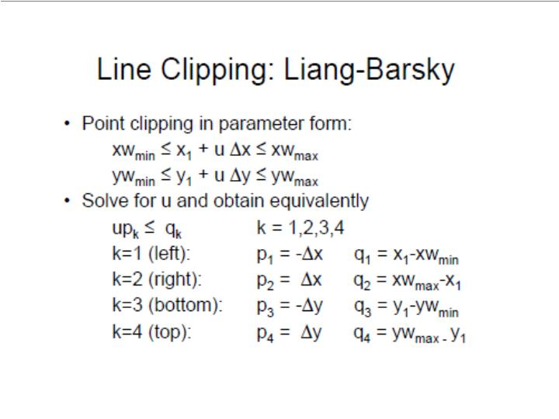

Slide 37
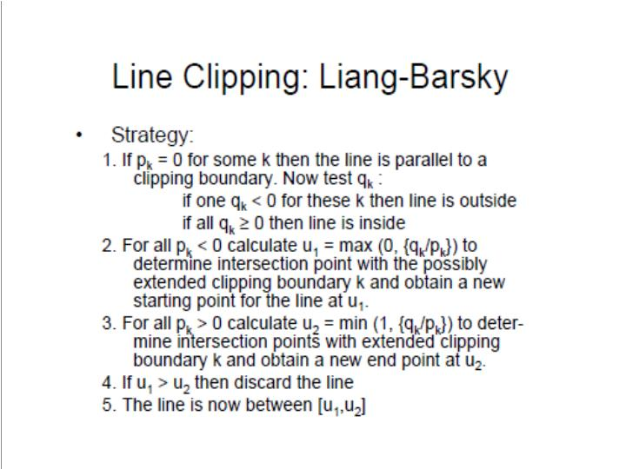

Slide 38
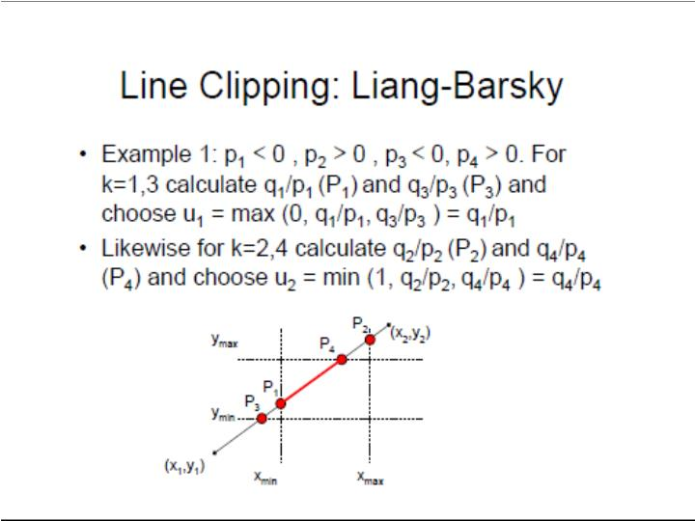

Slide 39
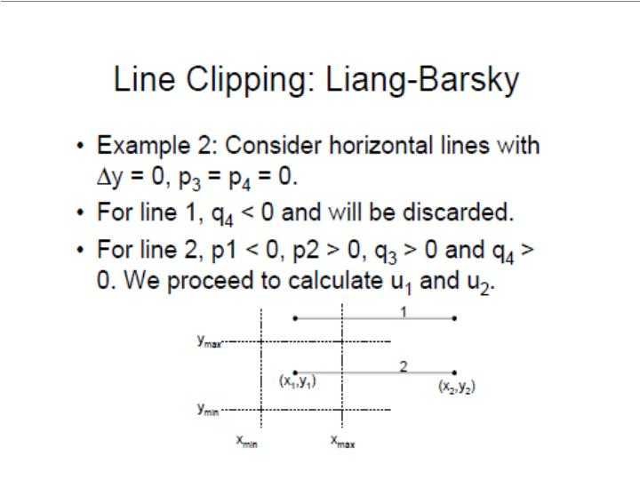

Slide 40
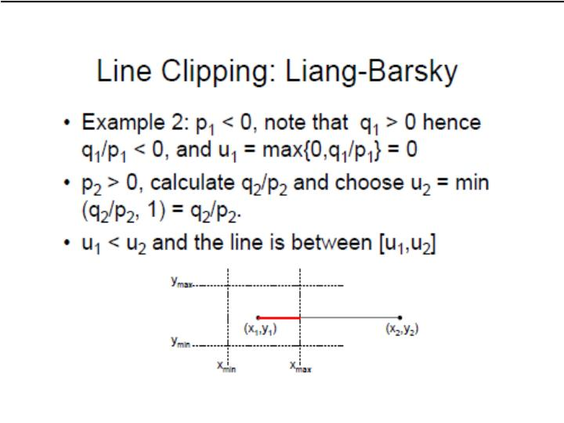

Slide 41
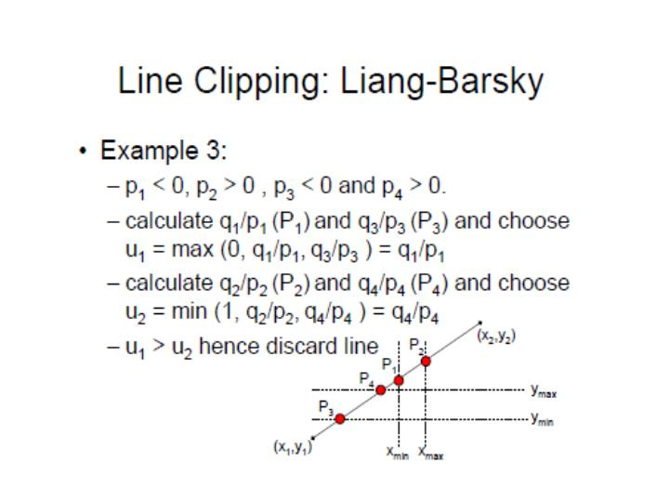

Slide 42
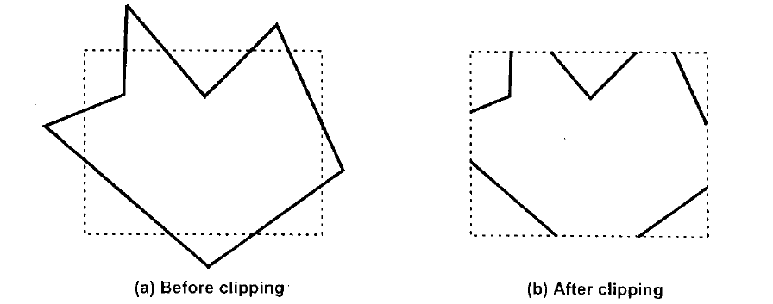
Polygon Clipping
Polygon is a surface enclosed by several lines.
Thus, Line clipping algorithm can be used directly for polygon clipping. But, it would produce a set of unconnected line segments as the polygon is exploded.
Herein lies the need to use a different clipping algorithm to output truncated but yet bounded regions from a polygon input.
Polygon clipping done by line clipping algorithm

Slide 43
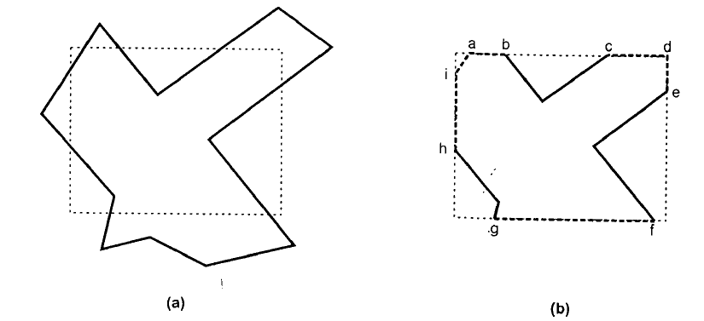
Polygon Clipping
A polygon is considered as a closed solid area. Hence, after clipping it should remain closed. To achieve this, there is need an algorithm that will generate additional line segment which make the polygon as a closed area. e.g. the lines a----b, c----d, d----e, f-----g and h-----i are added to polygon description to make it closed.

Slide 44
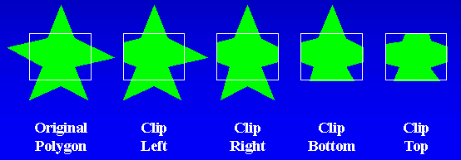
Polygon Clipping Sutherland-Hodgman Algorithm
Sutherland-Hodgman algorithm is one of the standard methods used for clipping arbitrary shaped polygons with a rectangular clipping window.
It uses divide and conquer technique for clipping the polygon, one window boundary at a time
It Accepts a series of polygon vertices and output another series of vertices defining the clipped polygon.

Slide 45
Polygon Clipping Sutherland-Hodgman Algorithm
The cases of the Sutherland-hodgman polygon clipping algorithm.
In words, the 4 possible Tests are applied to clip any polygon states are as mentioned below:
If the 1st vertex is outside the window boundary and the 2nd vertex is inside window, then both the intersection points of the polygon edge with window boundary and 2nd vertex are added to output vertex list.
If both Input vertices are inside the window boundary then only 2nd vertex is added to output vertex list.
If 1st vertex is inside the window boundary and the 2nd vertex is outside then, only the intersection edge with boundary is added to output vertex.
If both Input vertices are outside the window boundary then nothing is added to the output list.
Once all vertices have been processed for one clip window boundary, the output list of vertices is clipped against the next window boundary.

Slide 46
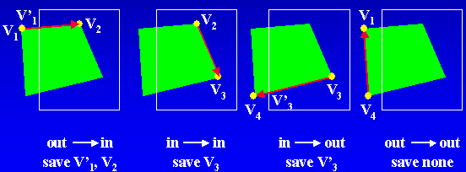
Polygon Clipping Sutherland-Hodgman Algorithm
Pass each pair of adjacent polygon vertices to a window boundary clipper
There are four cases:

Slide 47
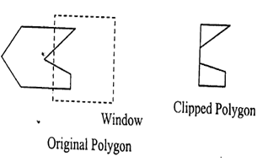
Polygon Clipping Sutherland-Hodgman Algorithm
Convex polygons are correctly clipped by the Sutherland-Hodgeman algorithm, but concave polygons may be displayed with extraneous lines. This occurs when the clipped polygon should have two or more separate sections. But since there is only one output vertex list, the last vertex in the list is always joined to the first vertex.
There are several things we could do to correctly display concave polygons. For one, we could split the concave polygon into two or more convex polygons and process each convex polygon separately.
Another possibility is to modify the Sutherland-Hodgeman approach to check the final vertex list for multiple vertex points along any clip window boundary and correctly join pairs of vertices.

Slide 48
Polygon Clipping Sutherland-Hodgman Algorithm
Sutherland-Hodgman Algorithm
Read coordinates of all vertices of the polygon
Read coordinates of the clipping window.
Consider the left edge of the window.
Compare the vertices of each edge of the polygon, individually with the clipping plane.
Save the resulting intersections and vertices in the new list of vertices according to four possible relationships between the edge and the clipping boundary.

Slide 49
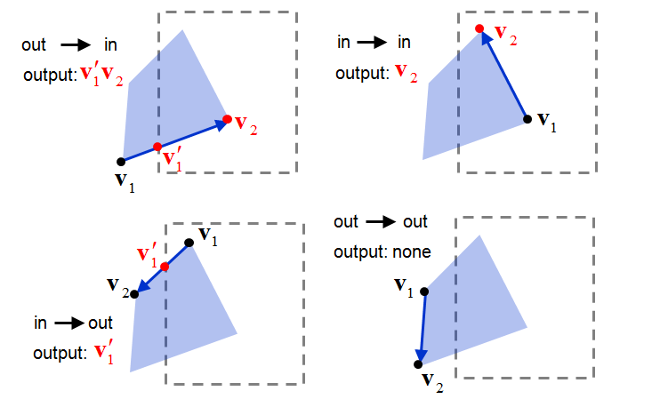
Polygon Clipping Sutherland-Hodgman Algorithm
Repeat the steps 4 and 5 for remaining edges of the clipping window. Each time the resultant list of vertices is successively passed to process the next edge of the clipping window.
Stop.

Slide 50
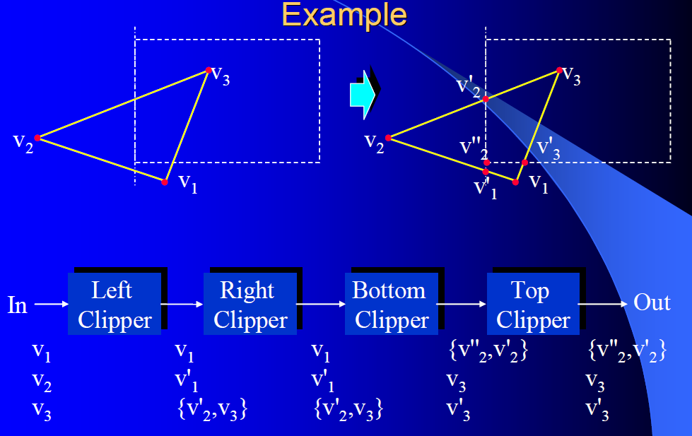
Polygon Clipping Sutherland-Hodgman

Slide 51
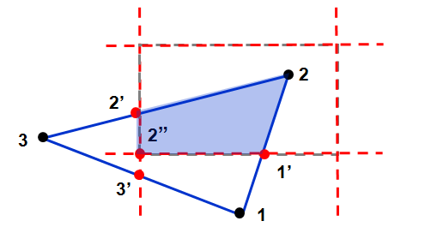
Polygon Clipping: Sutherland-Hodgman
Input | Left Clipper | Right Clipper | Bottom Clipper | Top Clipper
[1,2]: | (in-in)>{2}
[2,3]: | (in-out)>{2’} | [2,2’]:(in-in)>{2’}
[3,1]: | (out-in)>{3’,1} | [2’,3’]:(in-in)>{3’} | [2’,3’]:(in-out)>{2”}
 |  | [3’,1]:(in-in)>{1} | [3’,1]:(out-out)>{}
 |  | [1,2]:(in-in)>{2} | [1,2]:(out-in)>{1’,2} | [2”,1’]:(in-in)>1’}
 |  |  | [2,2’]:(in-in)>{2’} | [1’,2]:(in-in)>{2}
 |  |  |  | [2,2’]:(in-in)>{2’}
 |  |  |  | [2’,2”]:(in-in)>{2”}

Slide 52
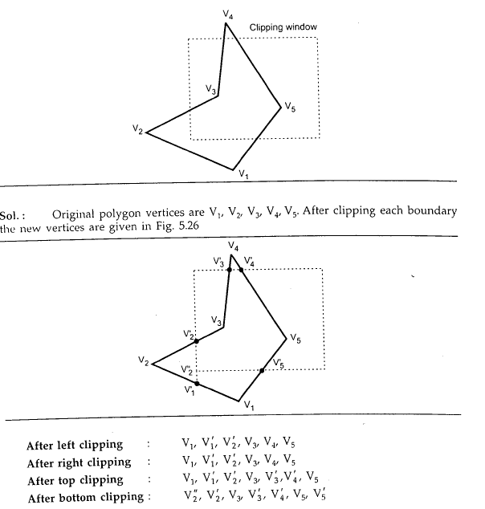
Polygon Clipping : Sutherland-Hodgman

Slide 53
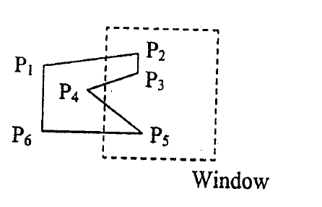
Polygon Clipping: Sutherland-Hodgman
Example
Illustrate the Sutherland-Hodgman algorithm for clipping the polygon P1 P2 P3 P4 P5 P6 against a rectangular window ABCD.

Slide 54
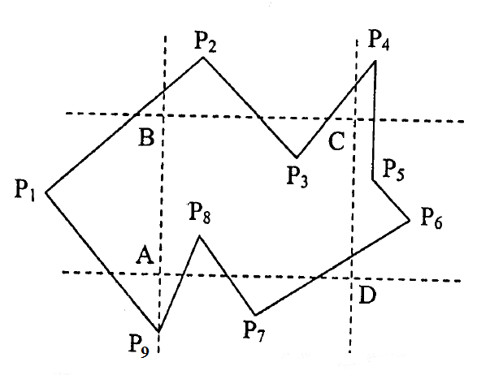
Polygon Clipping: Sutherland-Hodgman
Example
Illustrate the Sutherland-Hodgman algorithm for clipping the polygon P1 P2 P3 P4 P5 P6 P7 P8 P9 against a rectangular window ABCD.

Slide 55
Viewing Transformation
Viewing transformation is the mapping of a part of a world-coordinate scene to device coordinates.
In 2D (two dimensional) viewing transformation is simply referred as the window-to-viewport transformation or the windowing transformation.
Mapping a window onto a viewport involves converting from one coordinate system to another.
If the window and viewport are in standard position, this just
involves translation and scaling.
if the window and/or viewport are not in standard, then extra transformation which is rotation is required.

Slide 56
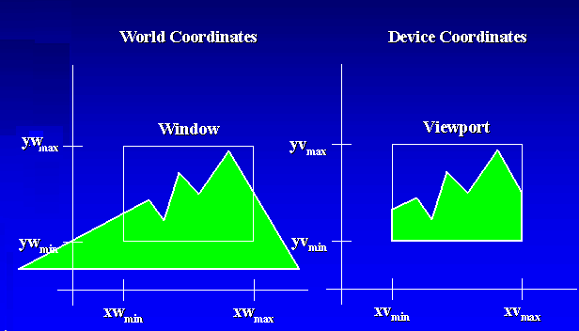
Viewing Transformation

Slide 57
Viewing Transformation
y-world
y-view
window
1
window
x-view
0
1
x-world
world
Normalised device

Slide 58
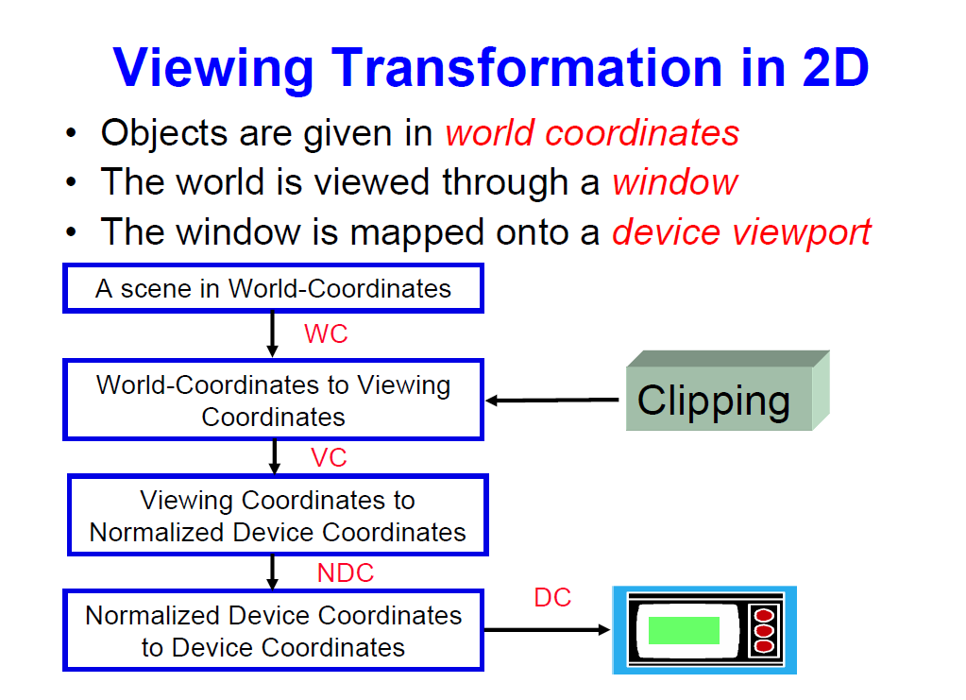

Slide 59
Viewing Transformation
The viewing transformation which maps picture coordinates in the world coordinate system to display coordinates in the physical device coordinate system is performed by the following transformations:
Normalization transformation(N)
Workstation Transformation(W)
Normalization transformation(N)
Different display devices may have different screen sizes as measured in pixels. Size of the screen in pixels increases as resolution of the screen increases. When a picture is defined in pixel values then it is displayed large in size on the low resolution screen while small in size on the high resolution .To avoid it and make the programs to be device independent, we define the picture coordinates in some other units than pixels and use the interpreter to convert these coordinates to pixel values for the particular display device. The device independent units are called the normalized device coordinates.

Slide 60
Viewing Transformation
Normalization transformation(N)
The interpreter uses a linear formula to convert the normalized device coordinates to the actual device coordinates.
x=
y=
Where x,y represent actual device x & y coordinate,
, represent normalized x & y coordinate,
represent width of actual screen in pixels,
represent height of actual screen in pixels.
The transformation which maps the world coordinate to normalized device coordinate is called normalization transformation. It involves scaling of x & y,thus it is also refereed to as scaling transformation.

Slide 61
Viewing Transformation
Window To Viewport Coordinate Transformation
Consider a point (xw,yw) in world coordinate system mapped to p’(xv,yv) in the device coordinate system.
In order to maintain the same relative placement in the viewport as in the window, the relationship is

Slide 62
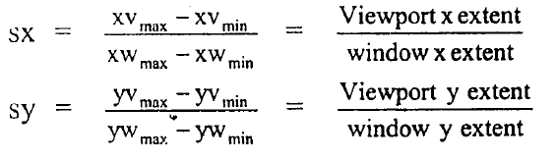
Viewing Transformation
Window To Viewport Coordinate Transformation
Solving the expressions,
Where sx,sy are the scaling factors.

Slide 63
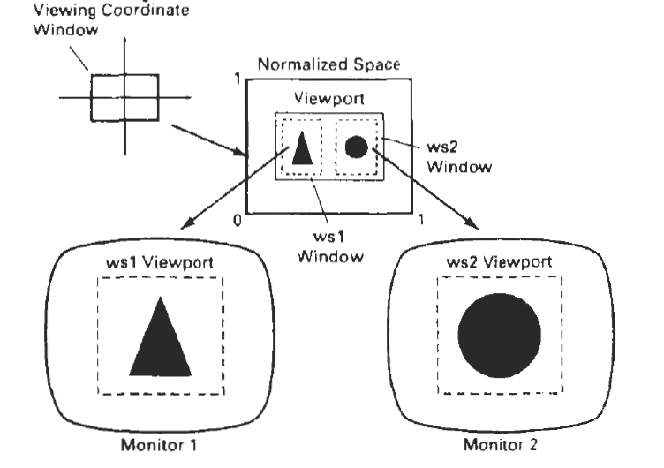
Window To Viewport Coordinate Transformation
When mapping window-to-viewport transformation is done to different devices from one normalized space, it is called workstation transformation.

Slide 64
Viewing Transformation
Window To Viewport Coordinate Transformation
The sequence of transformations are:
1. Perform a scaling transformation using a fixed-point position of (xw_{min,}yw_{min}) that scales the window area to the size of the viewport.
2. Translate the scaled window area to the position of the viewport.
Relative proportions of objects are maintained if the scaling factors are the same (sx = sy). Otherwise, world objects will be stretched or contracted in either x or y direction when displayed on output device.

Slide 65
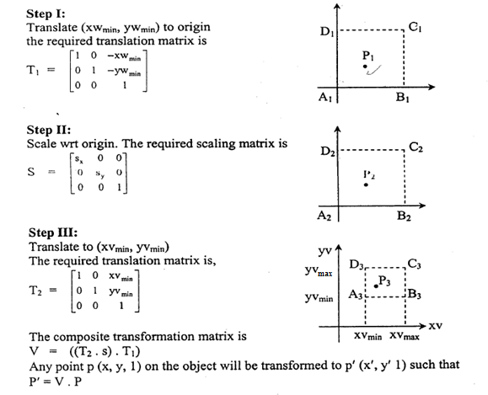
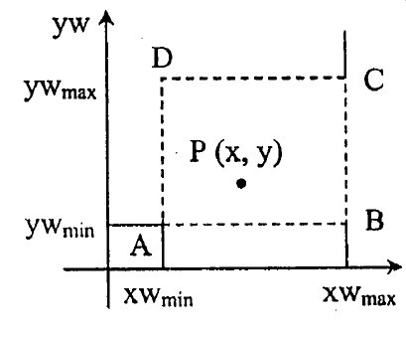
Viewing Transformation
The steps in the sequence of transformation is as follows:
Initial position of Window

Slide 66
Viewing Transformation
Find the normalization transformation window to viewport with window lower left corner at(1,1) and upper right corner at (3,5) onto a viewpoint with lower left corner at (0,0) and upper right corner at
Given Coordinates for window
xwmin=1 , ywmin=1
xwmax=3, ywmax=5
Given Coordinates for viewport
xvmin=0, yvmin=0
xvmax= yvmax=
Now calculate sx,sy.
sx=0.25
sy=0.125

Slide 67
Viewing Transformation
Transformation matrix is given by
Translate-Scale-Translate
Ans.

Slide 68
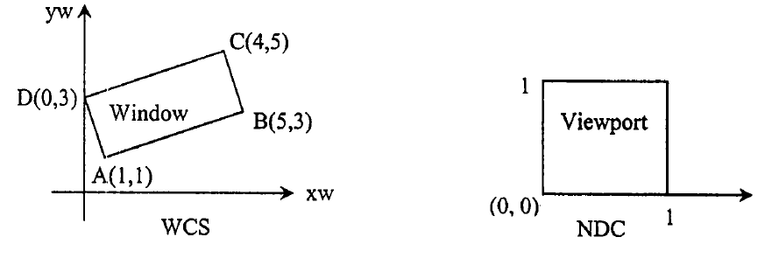
Viewing Transformation
Find a normalization transformation which uses the rectangle A(1,1),B(5,3), C(4,5) & D(0,3) as window and NDC as a viewport.

Slide 69
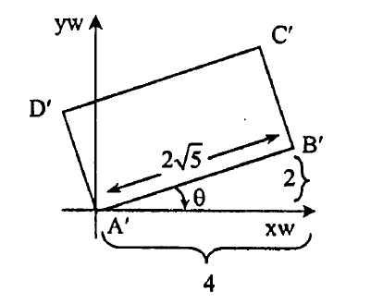
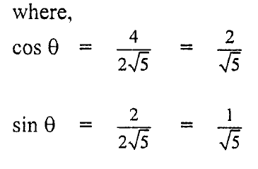
Viewing Transformation
Step-1. Translate point A(1,1) to origin. The required translation matrix is
T1=
Step-2.Rotate the rectangle about origin by an angle in clockwise direction so that it is aligned with the coordinate axis.
The required rotation matrix is
R=

Slide 70
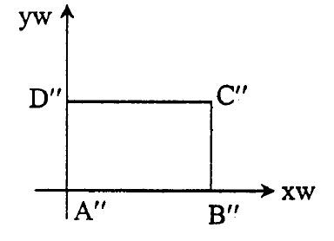
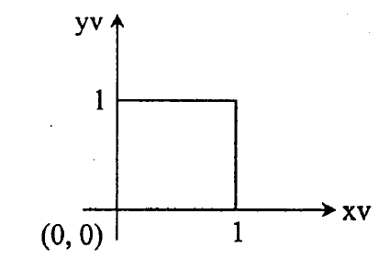
Viewing Transformation
Thus R=
Step-3.Perform scaling transformation V, that transforms window to viewport. The scaling matrix is
S=

Slide 71
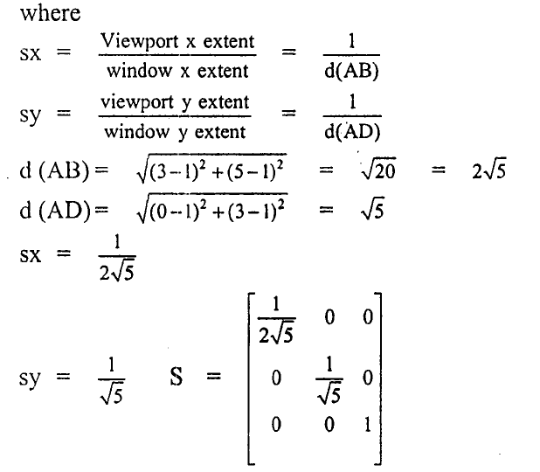
Viewing Transformation

Slide 72
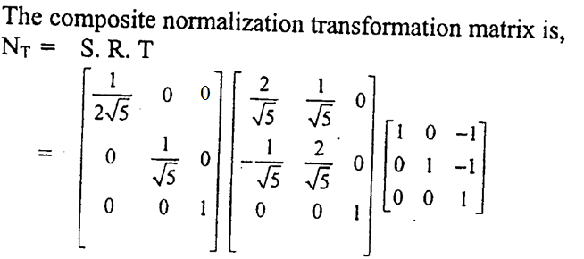
Viewing Transformation

Slide 73
Thanks…..

